Slide 1
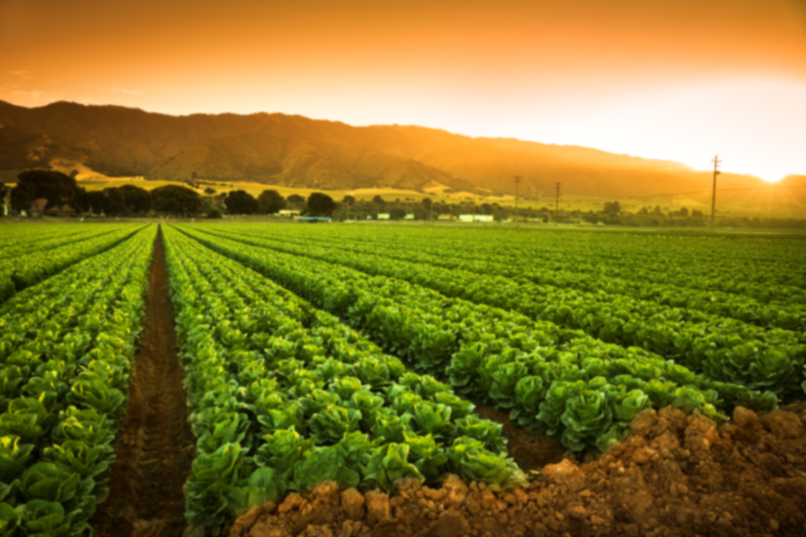
CONNECT AGRO!

Slide 2
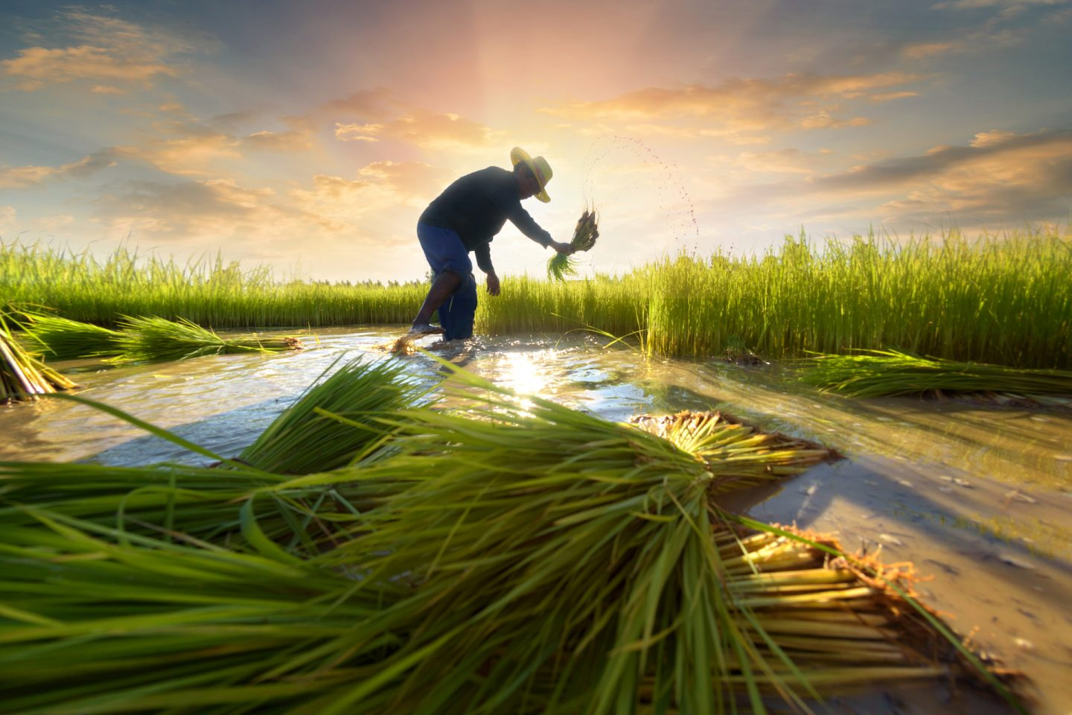
INTRODUCTION

Slide 3


SOME FACTS!
Agriculture is the backbone of INDIA we have heard this a number of times.
Over 56% of GDP’S contribution is by PRIMARY SECTORS.
Out of which 17% is covered by agriculture.

Slide 4
Lets first understand the problems faced by Farmers and Individuals?

Slide 5
PROBLEMS FACED BY FARMERS
FARMERS cannot cultivate the same crop throughout the year , so they go for any secondary source of income like cultivating any other crop or animal husbandry etc
For starting any new cultivation or any such , they need funds.
Government policy's also take time to get implemented, as well as it a long process.
Due to this farmers have to take loan from private banks and financers ,which ultimately leaves them in debt.
private banks and financers have a huge amount of interest rate which could lead to the farmer to the to life time debts
Day by day the interest of people towards farming is decreasing. Which has led to the decrease in the number of labours in the agriculture

Slide 6
PROBLEMS FACED BY INDIVIDUALS
Many times Individuals don’t know the products are coming from .
The involvement of middle man between farmers and individuals makes the product to cost more .
Fresh and quality products are not available in the market, since most of the good stuff are exported in the foreign countries.
The quality of food is decreasing because of manipulation.

Slide 7
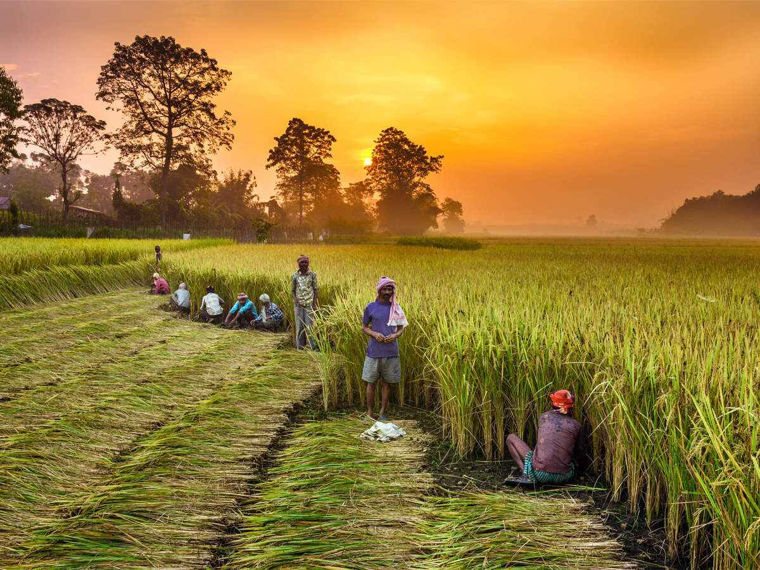
Lets see the impacts of the above problems !

Slide 8
IMPACTS
Day by day the price of the products are increasing.
Everyone is pursuing for a high reputed jobs this is decreasing the labours as people are not willing to take up farming as there occupation.
If the labours starts declining by 2051 half the crops will be cultivated , which will also affect our GDP.
If this continues by 2080 we will be struggling to fulfil our basic needs.
Many business tycoons are taking up this opportunity and are expanding there industries and construction by acquiring the farming land.
The rate of farmers suiciding has also increased.

Slide 9
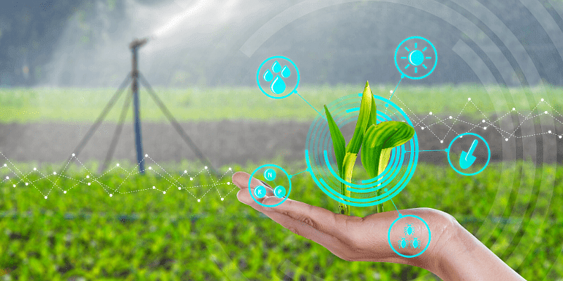
So here I present
CONNECT AGRO !
One solution for many problems

Slide 10

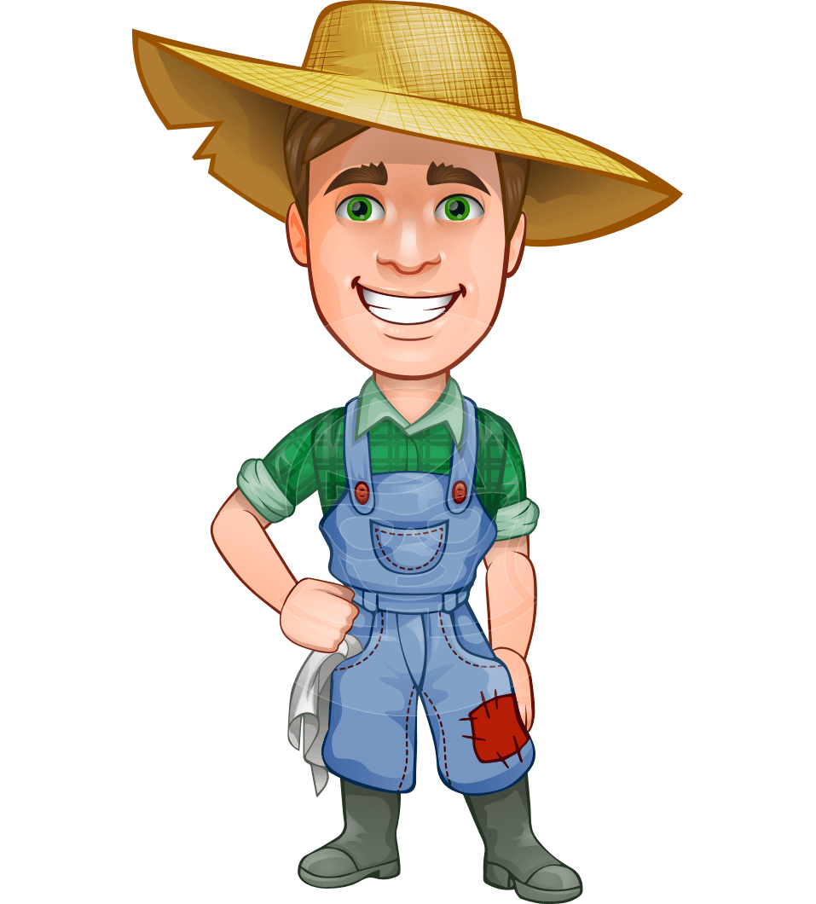


CONNECT AGRO IS PLACE WHERE FARMERS AND INDIVIDUALS CAN CONNECT EACH OTHER DIRECTLY!
CONNECT
AGRO

Slide 11

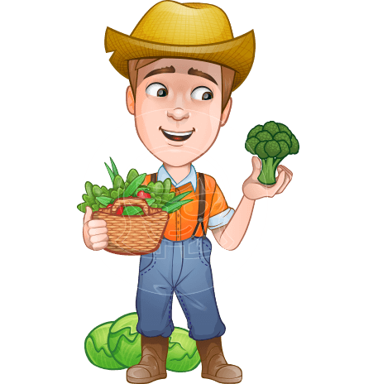

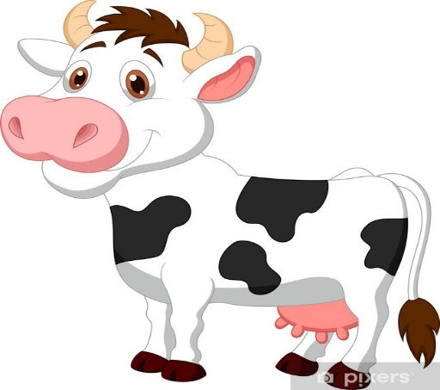
Farmers can directly ask for help they need such as money ,tractors ,fertilizers etc .since every farmer has his/her own needs and plans

Slide 12


Direct message & search system also allows the individuals and farmers to talk directly so that they can get more clarity and have a less chance of being cheated!

Slide 13


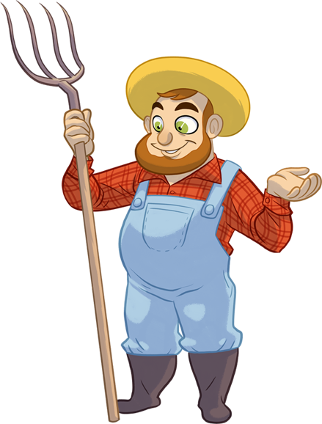
INDIVIDUALS CAN KEEP A CONTRACT BETWEEN FARMERS for mor safe and secure investments and for better understanding between both.

Slide 14
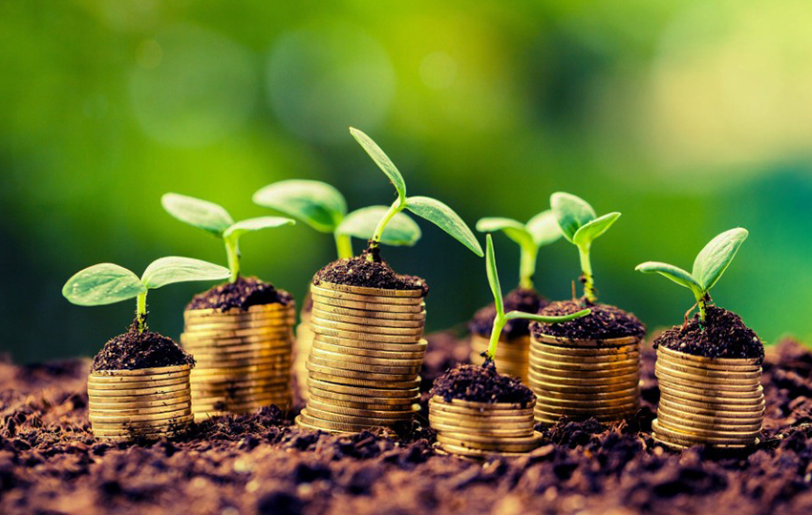
CONCLUSION

Slide 15
CONCLUSION
Farmers can get help instantly as compared to traditional method.
It will reduce cost of products and the due to which the middle man’s manipulation will not happen .
If individuals are benefiting the profit as grains then they know that where the food grains are coming from.

Slide 16

Conceived By
Karthik Jayan Nair

Slide 17
Thank You

Slide 18
THE END!

